Slide 1
BOC 1001/203 Supplemental Slides
BUILDING PUMPING SYSTEMS
Notes:
Supplemental slides for building pumping systems.

Slide 2
Pumping Overview
Common pumping applications in buildings:
Heating water, chilled water, condenser water
  Constant flow and variable flow
Domestic hot water re-circulation
  Constant flow
Pressure boosting
  Staged or variable flow
Notes:
Buildings with hydronic heating and/or cooling systems use pumps to deliver the heated or cooled water to heat exchangers. Water cooled equipment such as chillers and water source heat pumps use circulating condenser water loops to transfer the heat energy to a cooling tower. Pumps therefore are a major piece of mechanical equipment and can consume a large amount of energy.
Many buildings use domestic hot water circulation to ensure that hot water is available to the fixture during occupied hours. Finally, in mid rise and high-rise buildings, pressure boosting pumps are used to boost the city water pressure delivered to the building to ensure adequate water pressure on the top floors. This section covers pumping fundamentals and how to get the best efficiency from your pumping systems.

Slide 3





Common Pump Types
Base mounted end suction 40-4000 GPM
Close-coupled end suction 10-2500 GPM
Vertical in-line 10-2500 GPM
Close coupled in-line 7-280 GPM
Circulators 0-100 GPM
Courtesy Taco Pumps
Notes:
Not all pumps a alike. The most common type of pump used in commercial buildings is a centrifugal pump that uses an impeller to boost the pressure and circulate the water thru the system.
Base Mounted End Suction Pumps are used in larger hydronic distribution systems. The pump itself is de-coupled from the motor and a coupling is used to connect the pump to the drive motor. One advantage of base mounted pumps is that the motor can be removed and serviced without disturbing the pump.
Close-coupled end suction centrifugal pumps have similar applications as base mounted pumps except the motor is directly connected to the pump shaft. The advantage of this application is the elimination of the coupling which reduces maintenance (lubrication still required).
Vertical in-line pumps are used in the same applications as closed-coupled pumps. The advantage of the vertical configuration is a more compact pump that takes up less floor space.
Close-couple in-line horizontal pumps are used in smaller hydronic systems or where there are multiple pumping zones.
Circulators come in a variety of sizes and can be use in small hydronic systems as zone circulators or in domestic hot water recirculation systems with appropriate material.

Slide 4
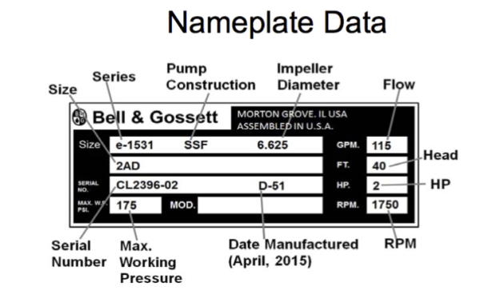
Pumping Terminology
Capacity
Head
Rated Speed
Horsepower
Impeller
BEP
Courtesy Bell & Gossett
Notes:
Access to nameplate or submittal data is key to operating your pumps efficiently. Everything you need to know about the pump may be included on the nameplate data. The base mounted pumps collect the nameplate data for the pump AND the attached motor.
Capacity is the gallons per minute flow at the specified pump speed and head pressure.
Head is the height at which a pump can raise water up at the rated flow. Total Dynamic Head (TDH) is the total equivalent height that a fluid is to be pumped, taking into account friction losses in the pipe.
Rated Speed is the rotating speed of the pump in RPM.
Horsepower is the maximum work rating of the electric motor.
An impeller is a rotating component of a centrifugal pump which transfers energy from the motor that drives the pump to the fluid being pumped by accelerating the fluid outwards from the center of rotation.
Best Efficiency Point (BEP) is the rate of flow and head at which the pump efficiency is maximum.

Slide 5
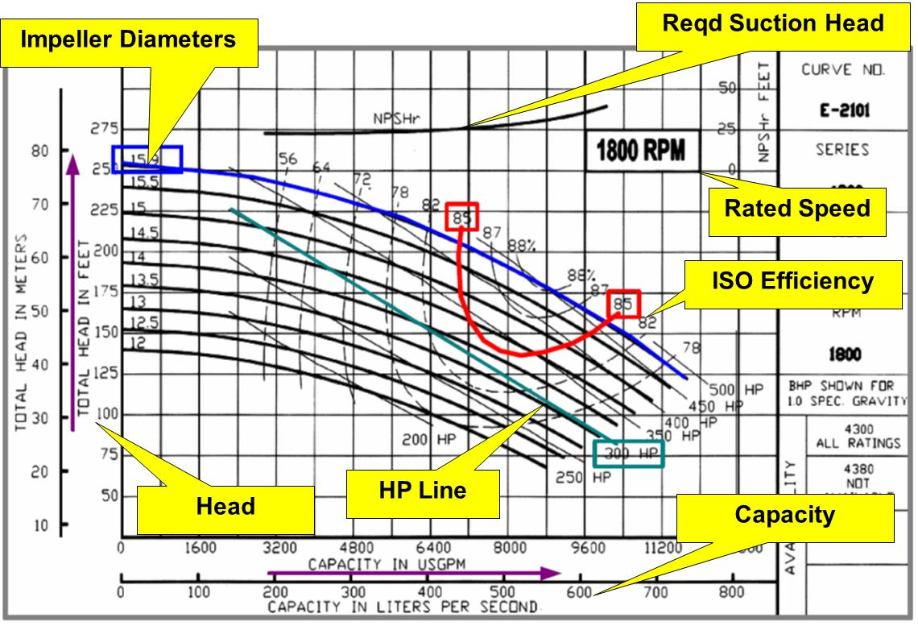
Typical Manufacturer Pump
Curve
Courtesy Hydraulic Institute
Notes:
This is a typical manufacturers published pump curve. Pump manufacturers test their pumps at different head, flow, impeller size , and rotating speed conditions to determine pump performance curves. The published pump curve also shows pump efficiency and horsepower requirements.

Slide 6
System Curve
H
H
Pump Curve
Speed
Impeller Dia.
Q
System Curve
Static Head
Friction
Q
For fixed speed pumps, the operating point is located at the intersection of the pump and system curves.
H = Head
Q = Flow
= operating point
Courtesy Hydraulic Institute
Notes:
The system curve is combined with the manufacturers published pump curve to determine the operating point of the of the pump. The system curve is determined by the flow and head pressure required including friction losses.

Slide 7
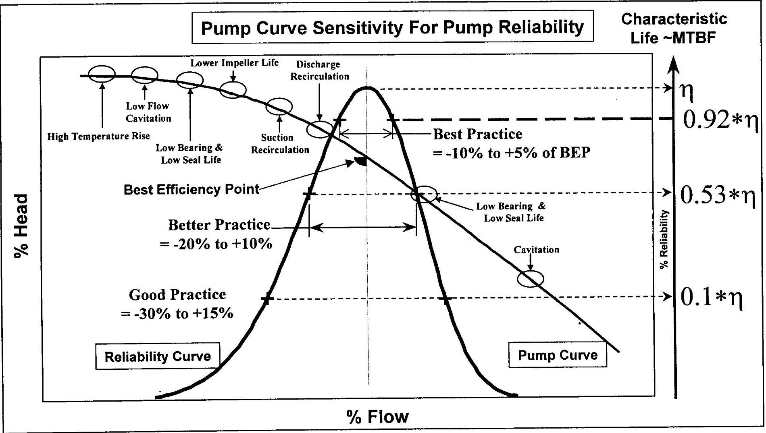
Pump Efficiency and Reliability
Courtesy: P. Barringer
Notes:
Pump operating conditions can have a significant impact on pump life and operating conditions. Best practice is to select the operating point within 10% of the Best Efficiency Point. Operating conditions outside this range can result in reduced bearing and seal life, cavitation, vibration and reduced impeller life.

Slide 8
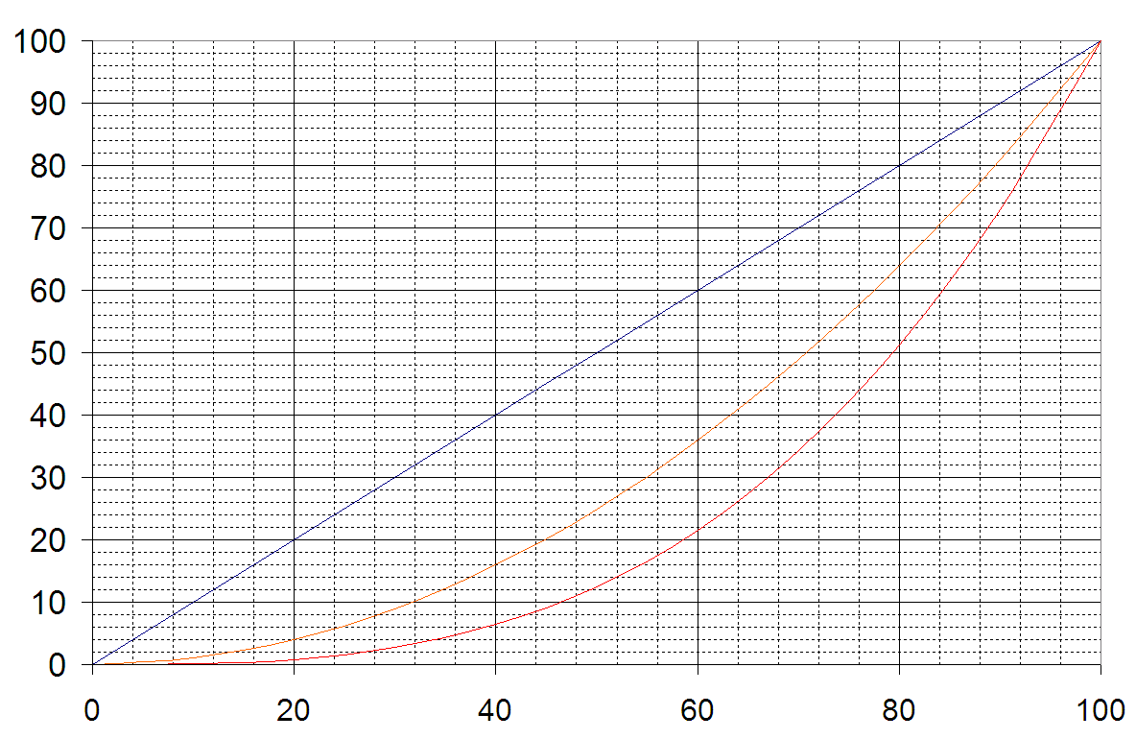
Variable Speed Pumping
Take advantage of the affinity rules of centrifugal pumps
% FLOW, HEAD, POWER
%SPEED
Courtesy Hydraulic Institute
Notes:
Anytime you can reduce the speed of a centrifugal pump and still meet your flow demand you save energy.
Pump Affinity Laws for a Specific Centrifugal Pump
Volume Capacity
The volume capacity of a centrifugal pump can be expressed like
q₁ / q₂ = (n₁ / n₂) (d₁ / d₂) (1)
where
q = volume flow capacity (m³/s, gpm, cfm, ..)
n = wheel velocity - revolution per minute - (rpm)
D= wheel diameter (m,ft)
Head or Pressure
The head or pressure of a centrifugal pump can be expressed like
dp₁ / dp₂ = (n₁ / n₂)² (d₁ / d₂)² (2)
where
dp = head or pressure (m, ft, Pa, psi, ..)
Power
The power consumption of a centrifugal pump can be expressed as
P₁ / P₂ = (n₁ / n₂)³ (d₁ / d₂)³ (3)
Where
P = power (W, bhp, ..)

Slide 9
Variable Speed Applications
When to use variable speed pumping?
Variable heating and/or cooling demand with 2-way valves
Domestic water pressure boosting pumps with variable water demand
Balancing constant flow systems in lieu of throttling valves
Notes:
The application of variable speed pumping is dependent on the type of zone valves in the system. 3-way or bypass valves require constant flow. Variable speed is ideal for 2-way valve systems where the demand for pump capacity is variable.
Domestic water service booster pumps in mid and high-rise buildings have typically use staged multiple pumps and buffer tanks to maintain the water pressure between minimum and high setpoints. Potentially resulting in varying pressure swings. Variable speed pumping solves this problem by maintaining consistent supply pressure and reduced need for buffer tank capacity.
Constant volume pumping systems can also benefit from variable speed pumping. Variable speed pumping is a more energy efficient method to balance flows then throttling valves.

Slide 10
Pump Opportunity
Indicators
Throttle valve-controlled systems
Bypass (recirculation) line normally open (no or low load)
Multiple parallel pump system with same number of
pumps almost always operating
Constant pump operation in a batch environment or
frequent cycle batch operation in a continuous process
Cavitation noise (at pump or elsewhere in the system)
High system maintenance
Systems that have undergone a change in function
Courtesy: Don Casada’s Evaluating Pump Systems

Slide 11
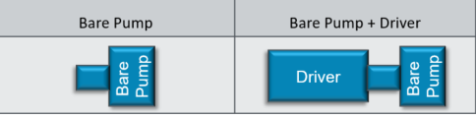
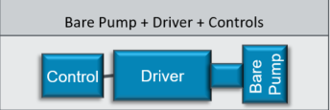
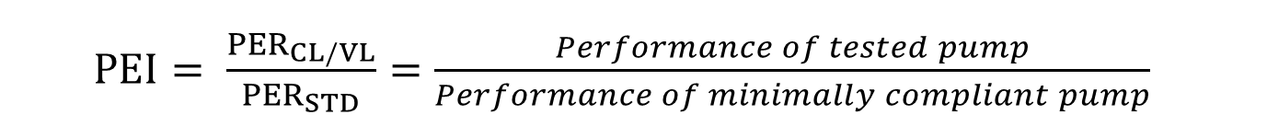


Pump Efficiency Index (PEI)
DOE metric for rating the efficiency of pumps and motors (like SEER rating for AC units)
PEI must be listed on pumps starting in 2020
Two types of PEI dependent on constant speed or variable speed applications
$PEI= \frac{{PER}_{CL/VL}}{{PER}_{STD}}=\frac{Performance of tested pump}{Performance of minimally compliant pump}$
Pump Energy Index | Constant Load Pump Energy Index (PEI_{CL}) | Variable Load Pump Energy Index (PEI_{VL})
Ratio
PER_{STD} | PER_{CL} for Minimally Compliant Pump of the Same Equipment Class Serving the Same Hydraulic Load (function of flow and specific speed at BEP)
Applicable Pump Configurations | Pumps Sold without Continuous or Non-Continuous Controls | Pumps Sold with Continuous or Non-Continuous Controls
Typical Range | 0.8-1.0 | 0.4-0.7
$${PEI}_{CL}=\left[\frac{{PER}_{CL}}{{PER}_{STD} }\right]$$
$${PEI}_{VL}=\left[\frac{{PER}_{VL}}{{PER}_{STD} }\right]$$
Notes:
The Department of Energy established PEI as a metric for rating the efficiency of pumps and pump systems. The PEI metric covers bare pumps, pumps sold with a motor, and pumps with a motor and continuous or non-continuous controls (i.e. variable flow).
This is a step-up from other efficiency ratings because it addresses the full scope of pumps, and gives pump purchasers the ability to easily compare the efficiency of different pumps For example, when comparing 2 pumps, the pump with the lower PEI has a higher efficiency rating
PEI must be listed on pumps starting in 2020. This allows system efficiency to be easily adopted into design criteria or used as a performance specification when purchasing/replacing pumps.

